Slide 1
MONGODB
ASSIGNMENT - 1

Slide 2
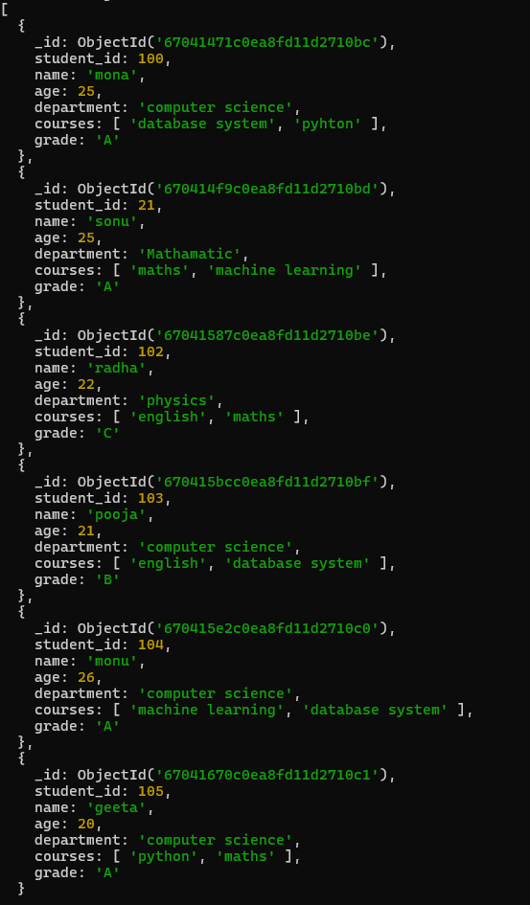
Create a new database called student_management. Create a collection called students in the student_management database. Insert at least five student records into the students collection. Each record should have the following fields: student_id (integer) name(string) age (integer) department (string) courses (array of strings) grade (string)

Slide 3
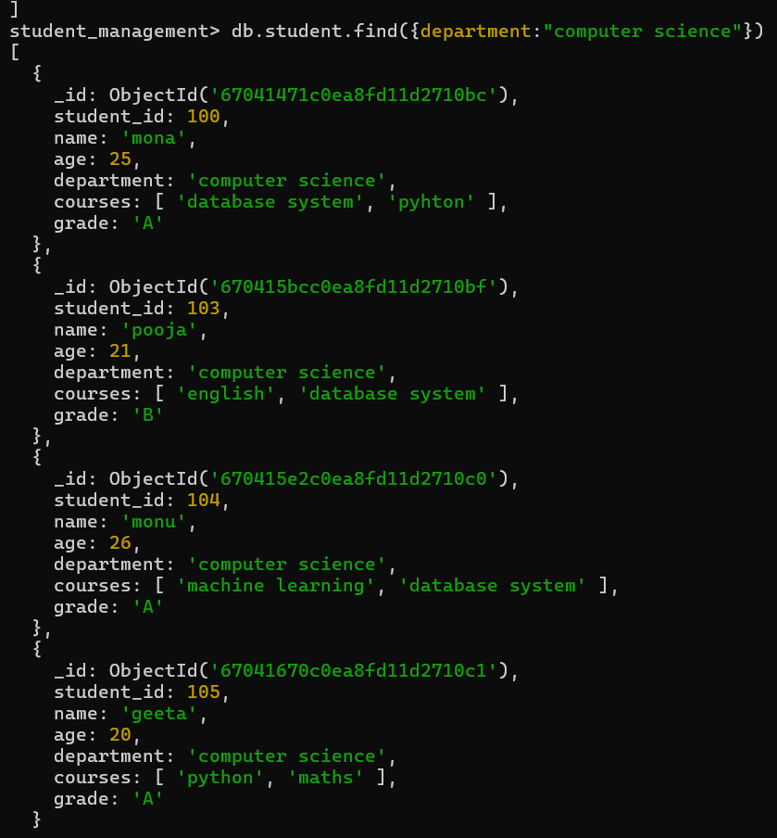
Query the Collection: Write queries to perform the following tasks: Retrieve all students who are in the "Computer Science" department.

Slide 4
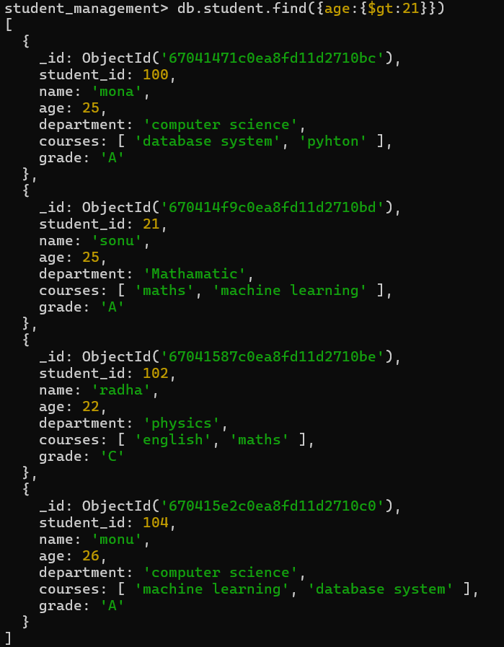
Retrieve students who have an age greater than 21.

Slide 5
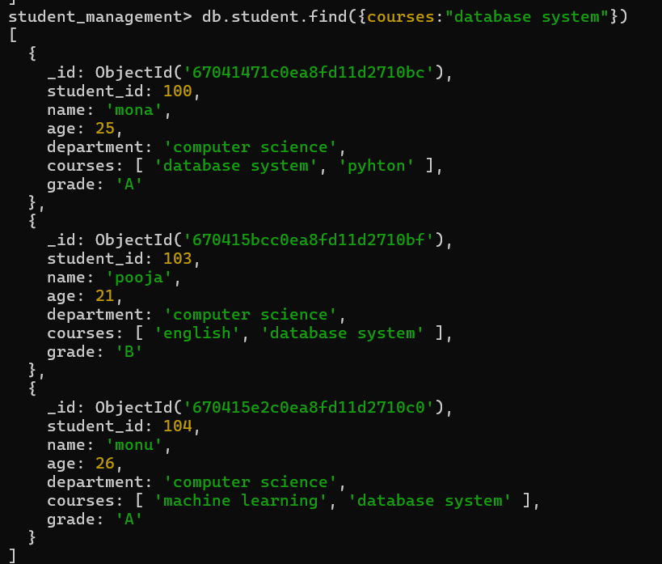
Retrieve students who are taking the "Database Systems" course.

Slide 6
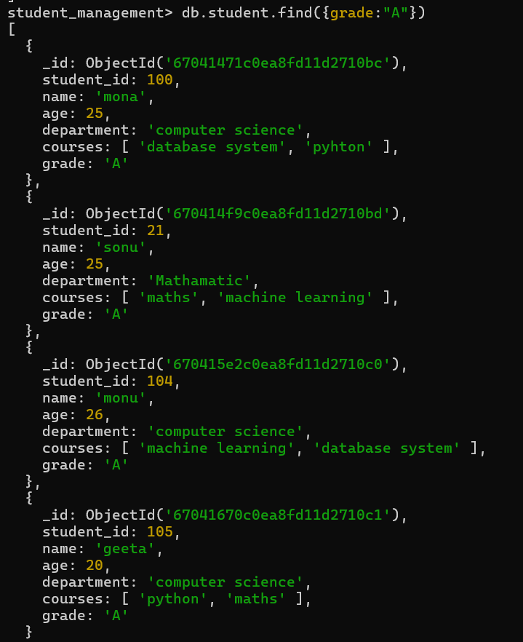
Retrieve students with a grade of "A".

Slide 7
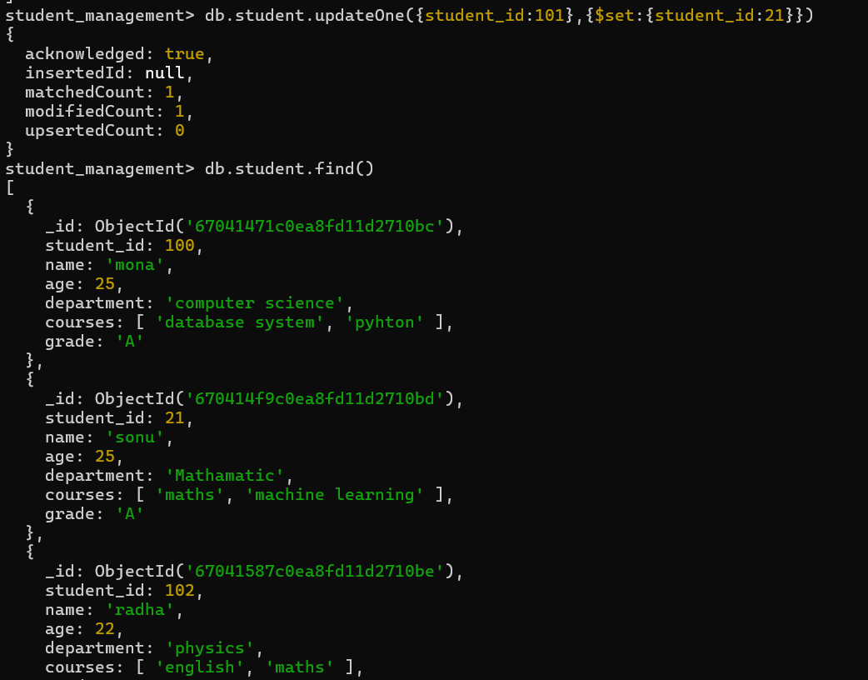
Update Documents: Update the age of a student with student_id 101 to 21.

Slide 8
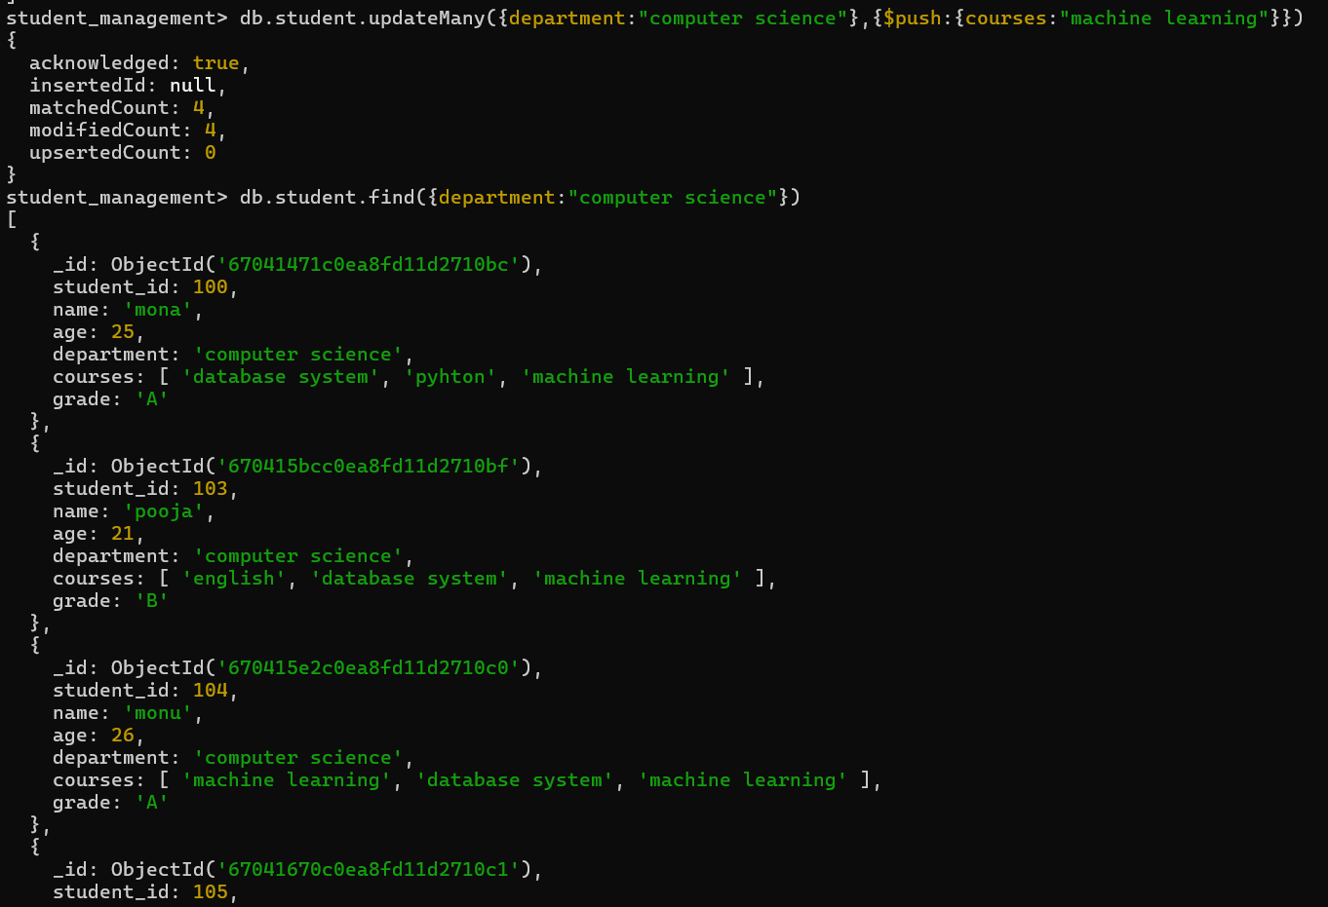
Add a new course, "Machine Learning", to the courses array for students in the "Computer Science" department.

Slide 9
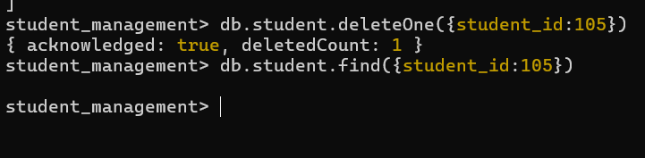
Delete Documents: Delete a student record with student_id 105.

Slide 10

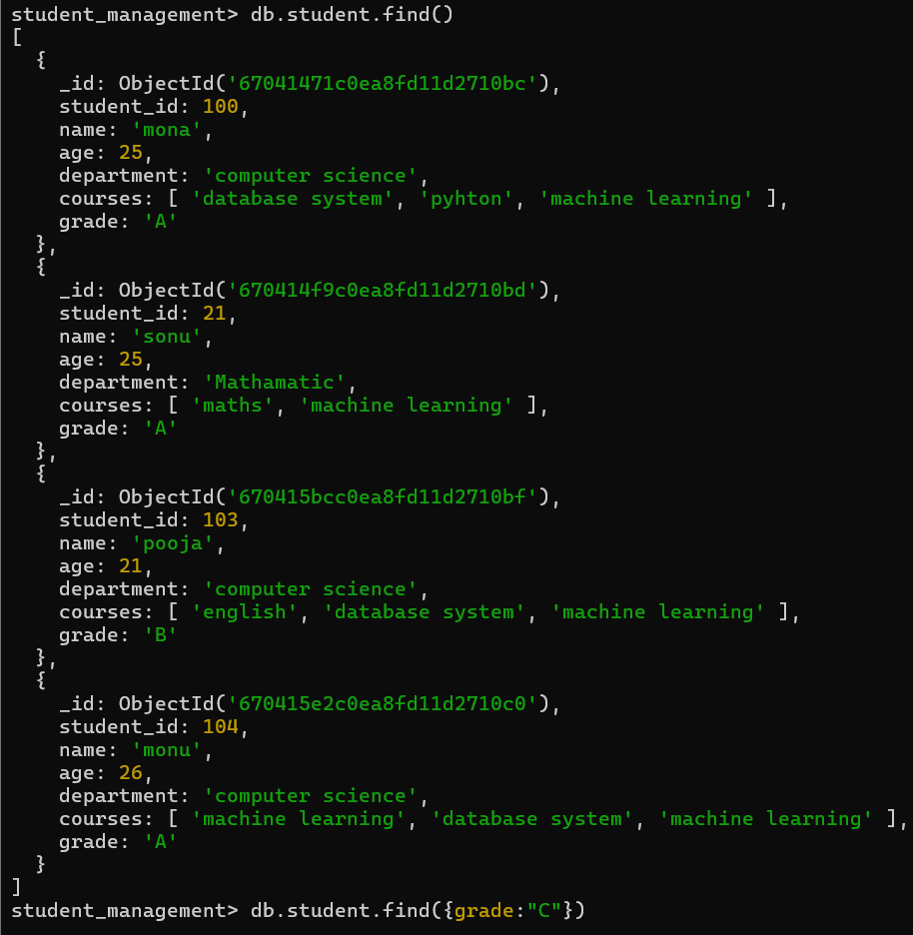
Delete all students who have a grade lower than "C".

